Slide 1

Music recommendation system
By Natasha Mwende

Slide 2
Table of contents
Project Overview
Data Overview
Data Preprocessing
Methodology
Conclusion

Slide 3

Project Overview

Slide 4
Why a music recommendation system?
With millions of songs available, finding new music that matches your taste can be overwhelming. But wouldn’t it be amazing if a system just got your taste? That’s where my music recommendation system comes in!
Instead of getting matches based solely on genre or artist name, my system uses text-based song features such as the song title, as well as numeric features such as tempo, energy, danceability, melodic structure, plays and listeners to provide recommendations that match your vibe perfectly.

Slide 5
How the recommendation system works
User enters song title or artist name
Fastext embeddings are used to convert text into numeric representations
Numeric features are normalized for consistent scaling
Text embeddings and numeric features are combined to form a comprehensive feature set
The recommended songs are displayed along with clickable YouTube links for easy listening
Cosine similarity is applied to make relevant song matches
Deep learning model is trained to learn patterns in the features
- Unlike music streaming platforms where recommendations are based solely on basic metadata like genre and artist name, my recommendation system makes suggestions based on both textual and numeric features.
- Overall, this system integrates deep learning, NLP, and similarity algorithms to provide music recommendations.

Slide 6
Data Overview

Slide 7
Data collection
- The dataset was compiled using data from Spotify, YouTube and LastFM.
- Basic song information, such as song name, artist, album, and popularity, was collected from Spotify.
- To include audio features, the corresponding songs were searched for on YouTube, downloaded, and analyzed using Librosa, which allowed for the extraction of audio metadata such as tempo, energy, spectral rolloff, and chroma.
- Lastly, data on the song genres, play count and number of listeners was collected from LastFM to further enrich the dataset.

Slide 8
UNDERSTANDING THE DATA
The resulting dataset contained 6,773 entries and 14 columns.
The columns include:
Song ID: Unique identifier for the song on Spotify.
Name: Song title.
Artist: Name of the performing artist.
Album: Album the song belongs to.
Popularity: Popularity score of the song on Spotify.
YouTube URL: Link to the song on YouTube.
Tempo: Speed of the song in beats per minute (BPM).

Slide 9
Energy: A measure of loudness and intensity. Higher values indicate louder and more energetic tracks and vice versa.
Spectral Rolloff: A measure of the frequency content of the song.
Chroma: Measures intensity of different pitches/notes in the song. It helps analyze the harmonic and melodic content of a song, where higher values imply strong melodic structure and lower values suggest that a song relies more on beats and rhythm than melody.
Danceability: A score indicating how suitable the song is for dancing, derived from tempo and beats.
Genre - A list of genres that the song falls under.
Listeners - Number of unique listeners for the song.
Plays - Total number of times the song has been played.

Slide 10
Data Preprocessing

Slide 11
1. FEATURE ENGINEERING
A new feature called replayability was created by dividing the play count by the number of unique listeners to indicate how often a song is being replayed by its audience.
Higher replayability scores suggest that listeners frequently replay the song, indicating strong engagement and popularity, while lower scores imply that a song is played less frequently per listener, potentially reflecting lower listener engagement or appeal.

Slide 12
2. MULTI–HOT ENCODING
Since songs can belong to multiple genres, the genre column contained lists of genres, and it was transformed using multi-hot encoding.
Each unique genre was converted into a separate binary column, where a value of 1 indicates that the song belongs to the genre, and 0 means it does not.
This transformation ensures that the dataset properly represents genre information in a format suitable for machine learning models.

Slide 13
3. TEXT PREPROCESSING
During this step, text data was prepared for modeling using various Natural Language Processing (NLP) techniques.
Text Tokenization: I used NLTK to break down song names into individual tokens i.e words or sub-words for further processing. Tokenization helps to standardize text data by splitting it into smaller components, making it easier to process and analyze.
Text Vectorization: To capture meaningful relationships and similarities in the text data, I experimented with multiple vectorization techniques before settling on FastText due to its ability to capture semantic relationships between words across different languages. This was particularly important since my dataset contained song names in multiple languages, not just English.

Slide 14
Why FastText?
FastText, developed by Facebook AI, is an advanced word embedding model that improves traditional vectorization in the following ways:
Sub-word Representations - FastText breaks words into smaller sub-word units (n-grams). This is particularly useful for handling misspellings, rare words, and multilingual text. For example: The word "love" might be represented by sub-words like "lo", "lov", "ove", etc. This means even if a song title contains variations or typos, the model can still find meaningful similarities.
Handling Multilingual Data - Since song names in my dataset were in multiple languages, FastText helps bridge the gap between different languages by learning shared patterns across words. For example: "love“ in English, and "amor" in Spanish, might have similar vector representations because FastText captures contextual similarities.

Slide 15
4. FEATURE SCALING
All the numeric columns in the dataset contained data in different ranges. In order to ensure consistency across all the numeric features, MinMax Scaling was applied to standardize values within the range 0 to 1.

Slide 16
All the mentioned preprocessing steps create a well-structured feature set.
To ensure a balanced contribution from the different song attributes, the textual, numeric and genre information were weighted before being combined.
Genre features were given less weight in order to prevent genre from overpowering the other factors when the model makes recommendations.
The combined data is then fed into a deep learning model that enables accurate similarity calculations for recommendations.

Slide 17
Methodology

Slide 18
1. Deep learning model
BUILDING THE RECOMMENDATION SYSTEM
To improve the accuracy of song recommendations, I used a neural network that learns patterns in the songs beyond just genres and artist names. Instead of relying only on basic details, the model understands deeper relationships between songs.
How the Deep Learning Model Works
Input Layer: Once all the textual and numeric features are preprocessed, they are combined into a single feature vector for each song. These feature vectors serve as the input to our deep learning model.
Learning Patterns: The model has multiple hidden layers that process these feature vectors. These layers apply mathematical transformations including activation functions (such as ReLU). The aim of these functions is to introduce non-linearity which helps the model to discover complex relationships and deeper patterns, like how tempo or energy levels make songs feel similar.
Preventing Overfitting: To ensure the model works well on new songs, dropout layers randomly ignore some neurons during training. This helps the model generalize well.
Making recommendations: After training, the model transforms a new song or a user query into a feature vector that encodes its features. It then compares this vector to all other songs in the dataset using cosine similarity to find the closest matches. The most similar songs are then recommended based on learned patterns.

Slide 19
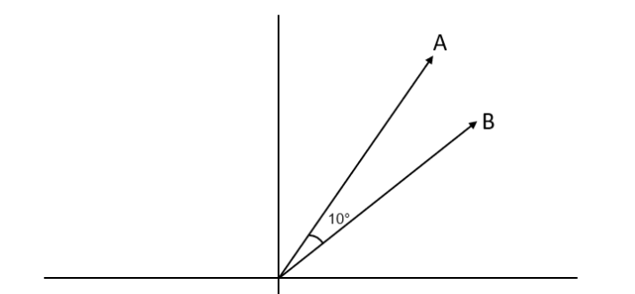
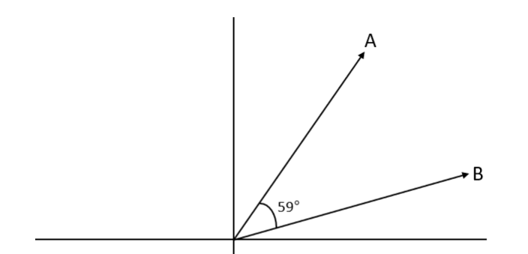
2. Cosine similarity calculation
Cosine Similarity is a technique used to measure how similar two songs are by comparing their feature vectors. Each song and its characteristics is represented by a vector, cosine similarity checks how closely song characteristics align by measuring the angle between their feature vectors, focusing on their direction/orientation.
A smaller angle(closer to 0) means the songs are very similar and have similar features.
A larger angle(closer to 90) means the songs are different or not similar.
The similarity score ranges from 0 to 1, where 1 indicates very similar songs and 0 means no similarity between the songs.
Since the feature vectors used are a combination of numeric and text-based features, this ensures that the recommendation system finds songs that are both musically and thematically similar.

Slide 20
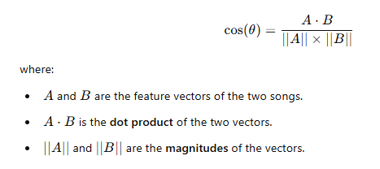
EXAMPLE: STEP BY STEP COSINE SIMILARITY CALCULATION
We will use 3 songs (A, B and C) in our calculations.
The goal is to see which song is most similar to song A using cosine similarity.
Cosine similarity is computed using the following formula:

Slide 21
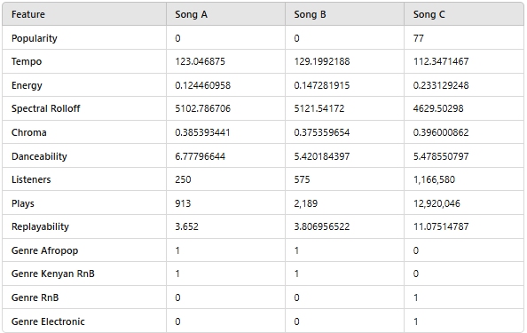
Below is a table containing data on the numeric features of the 3 songs, Lucy by Bensoul (Song A), Nikita by Nviiri the Storyteller (Song B) and Needed Me by Rihanna (Song C).
For simplicity, the example uses unscaled values. However, in the actual model, all numeric features are scaled to ensure consistency.

Slide 22
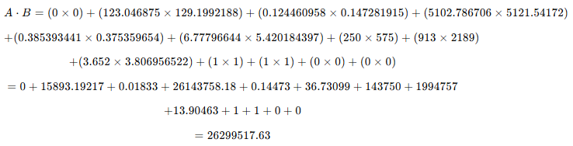
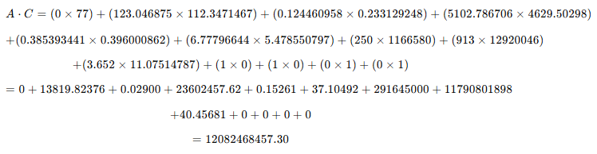
Step 1: Computing the dot product
The dot product between song A and B is calculated as:
The dot product between song A and C is calculated as:

Slide 23
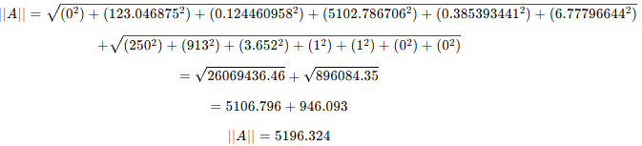
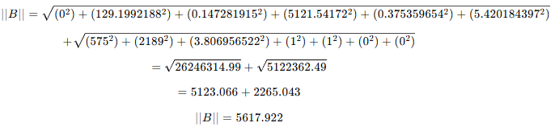
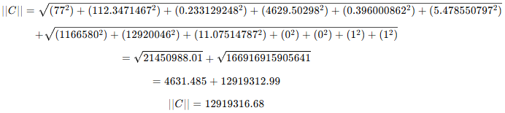
Step 2: Computing the magnitudes of each vector
- The magnitude of vector A is calculated as:
- The magnitude of vector B is calculated as:
- The magnitude for vector C is calculated as:

Slide 24
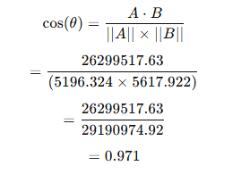
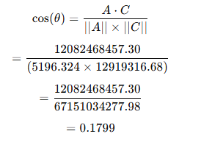
Step 3: Computing cosine similarity
Cosine similarity between song A and song B and between song A and song C:
Interpretation:
Lucy and Nikita have a high cosine similarity of 0.971 meaning they are extremely similar in terms of their features and would likely be recommended together.
Lucy and Needed Me on the other hand have a lower cosine similarity of 0.1799 which means that the two are quite different.

Slide 25
How Deep Learning and Cosine Similarity Work Together
The deep learning model takes in the preprocessed song features and learns a refined feature representation for each song. The model captures hidden relationships that raw features may not fully express, making similarity comparisons more meaningful.
Since raw features may not accurately reflect musical similarity, the deep learning model first transforms them into a more structured, high-level representation before comparison.
Once trained, cosine similarity is applied to these learned representations to measure song similarity and identify the best matches.
The system transforms a user’s query into a learned feature vector and finds the top 5 most similar songs for recommendations.

Slide 26
3. Making recommendations
The recommendation system makes recommendations based on either the song title or an artist name.
Song-Based Recommendations:
The model predicts the feature vector of the input song.
Cosine similarity is computed against all songs in the dataset.
The top 5 most similar songs are returned as recommendations.
Artist-Based Recommendations:
Retrieve songs by the artist: The system filters and returns songs by the input artist.
Find similar songs from different artists:
The model first averages the feature vectors of all songs by the input artist to create an artist-level feature representation.
This artist vector is then compared against all songs in the dataset using cosine similarity.
The top 5 most similar songs, by different artists sharing similar musical characteristics, are returned.

Slide 27
4. Streamlit ui
In order to provide an interactive and user-friendly experience, the recommendation system was deployed using Streamlit.
The UI allows users to input a song title or artist name, and in response, the system displays the top recommended songs.

Slide 28
Features of the UI
User Input Section: Users can enter a song name or artist, which serves as the query for generating recommendations.
Artist Query Option: If the query is an artist name, the UI provides a toggle option that allows users to choose between:
Songs by the same artist - to explore more music from the artist.
Songs similar to the artist’s music - to discover new artists with a similar style.
However, if the query is a song name, the toggle option does not appear and similar songs to the query are recommended.
Recommendation Display: The top 5 most similar songs to the query are displayed and each recommended song includes a clickable YouTube link, allowing users to listen to the song.

Slide 29
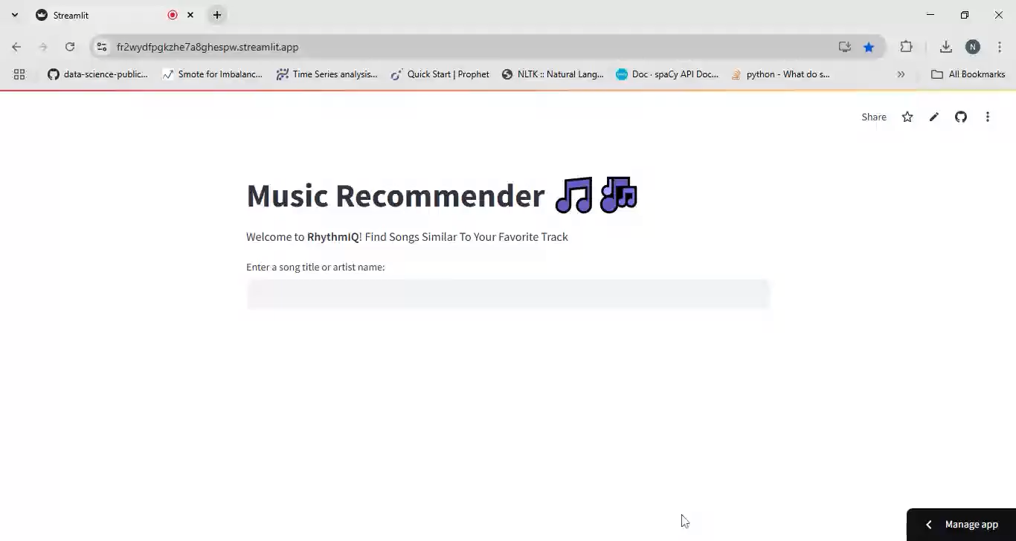
How the app works

Slide 30
Conclusion

Slide 31
Future improvements
Expanding the dataset to include a larger collection of songs.
Incorporating user feedback , user preferences and past listening history to further personalize recommendations.
Combine collaborative filtering with the existing content-based filtering to create a hybrid approach for better recommendations.

Slide 32

Thank you

